Slide 1
Exercise 1 – HH model
Sagi furman - 311603476
Resting potential set to -65mV.
Trials’ length set to 100mS, unless reported otherwise.
Time steps set to 1uS
Further instructions and setting description are mentioned in the analysis code

Slide 2
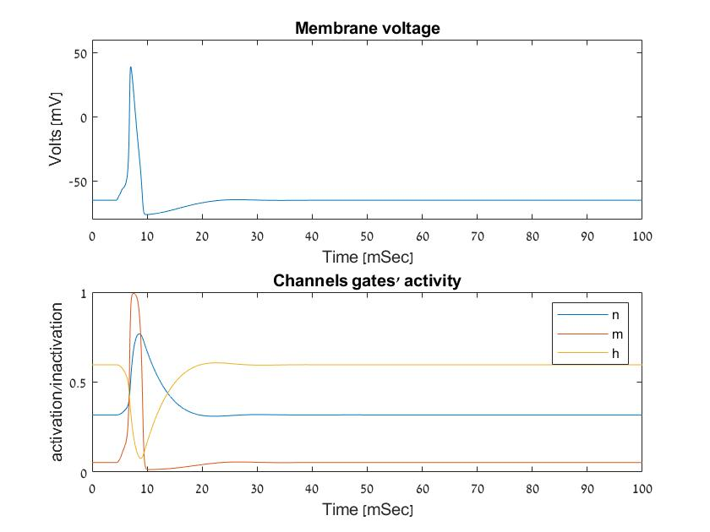
Paragraph 1
10uA current was injected for 1mS (4.5-5.5mS trial time).
The upper graph shows the membrane voltage as a function of time, with the mentioned current.
the lower graph shows the chain reaction of the activity of the channels gates, in response to current injection.
The fast active reaction of m gates together with less faster inactive reaction of h gates open sodium channels, allowing positive ions (Na+) into the neuron affecting the membrane voltage very quickly. The rise in n gates activity open potassium channels, which allows positive ions (K+) out of the neuron. This, and quick inactivity of m gates creates a sharp drop in the voltage.
The slow inactivity of n gates and slow activity of h gates create a state called hyperpolarization, which refers to the period between the action potential and the return to resting potential.

Slide 3
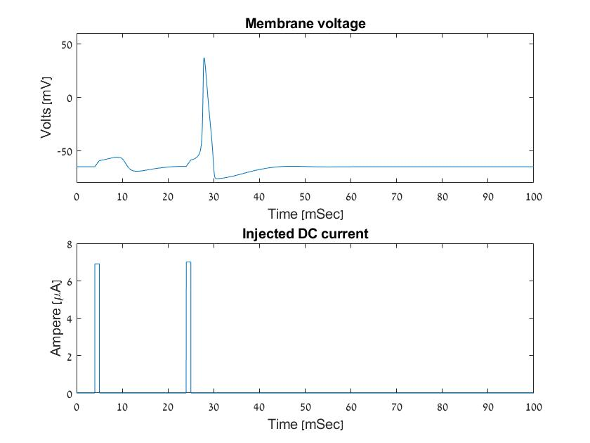
Paragraph 2 – limited injection
6.9uA and 7uA currents were injected for 1mS each (4-5mS and 24-25mS trial time, respectively).
We can see from the upper graph that the membrane voltage reacts differently for each current, which Indicates that there is a voltage threshold from which the neuron reacts and fire.
Within the time range (1mS), the first current influences the chemical gates enough in order to create the chain reaction we may see in the latter current.

Slide 4
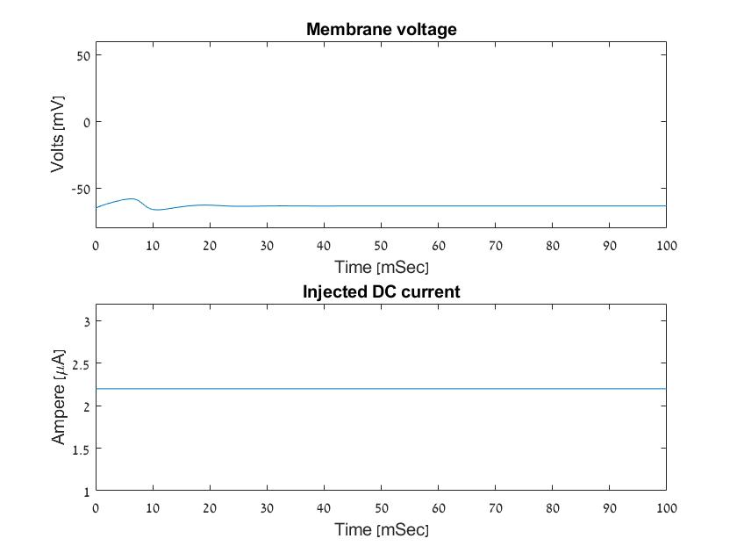
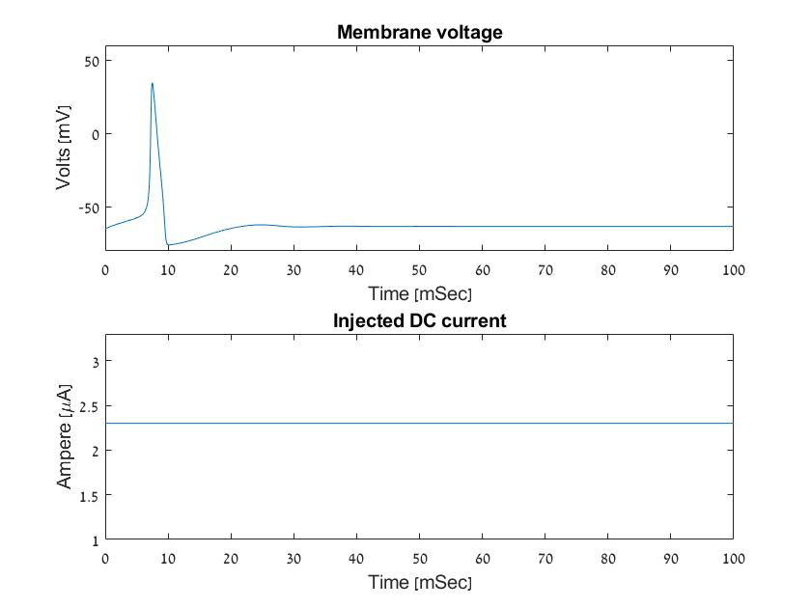
Paragraph 2 – limitless injection
If injected limitless current that equals 2.2uA, the neuron reacts, does not fire and stabilizes.
However, if injected limitless current that equals 2.3uA, the neuron fires only once then stabilizes. That is due to biological reasons - n gates and h gates weren’t given enough time to return to their status-qou activation, therefore stabilizing on other activation, which does not generate more action potentials

Slide 5
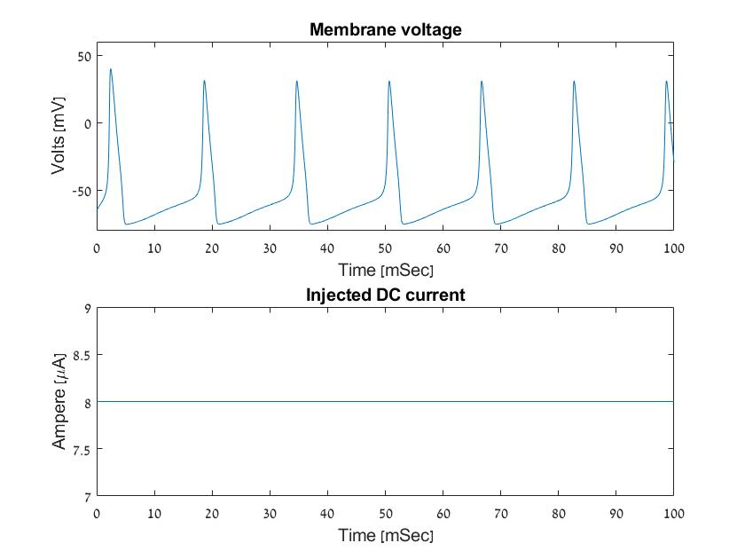
Paragraph 3
At a limitless current (=8uA) which is greater than the critical current found in the limited injection paragraph (=7uA), we can see a repeated pattern of the membrane voltage - Action potentials.
With a steady current, the next AP can be generated only after the hyperpolarization period is over.

Slide 6
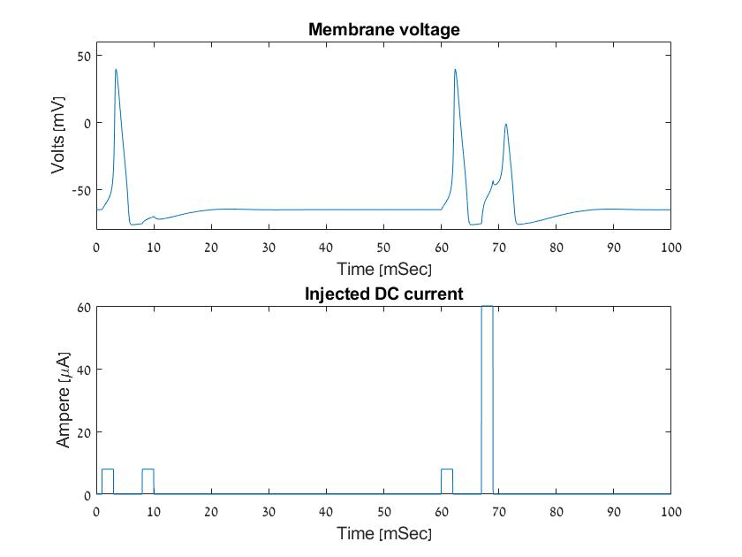
Paragraph 4
To prove the existence of a refractory period, two 8uA currents were injected for 2mS each with short 5mS pause between them (1-3mS and 8-10mS trial time). We can see that the neuron fires in reaction to the first only.
To overcome that period at the same time table, it was needed to increase the Ampere of the second current to 60uA (almost 8 times greater!)
The refractory period relates directly to the hyperpolarization period, which refers to the stage were the chemical gates are still stabilizing and less affecting the voltage. In other words, n gates are more active and h gates are less active in comparison to resting activation

Slide 7
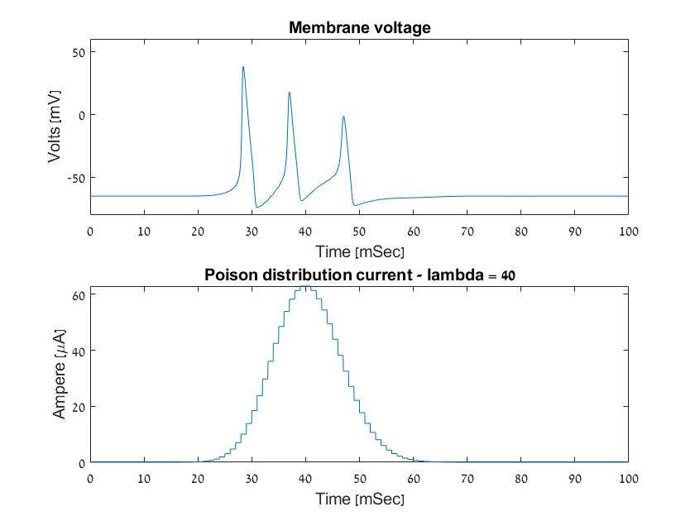
Paragraph 5
When the current derives from a Poison distribution, we can see an uneven pattern of action potentials in the upper graph.
The increase of current overcomes the refractory period of the first AP. However, the decrease of current generates an irregular shape of an AP.

Slide 8
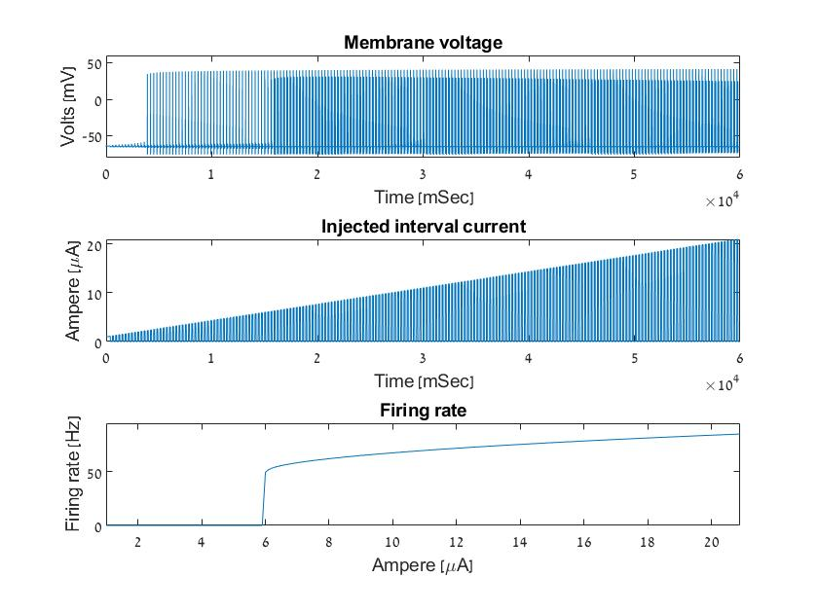
Paragraph 6
In this section, trial time was set to 60 seconds.
In the upper graph, we can see the reaction of the membrane voltage changes respectively to the increasing Ampere showed in the middle graph.
The lower graph shows the firing rate (spikes/sec) of the neuron. We can see it increasing exponentially from approximately 6uA.

Slide 9
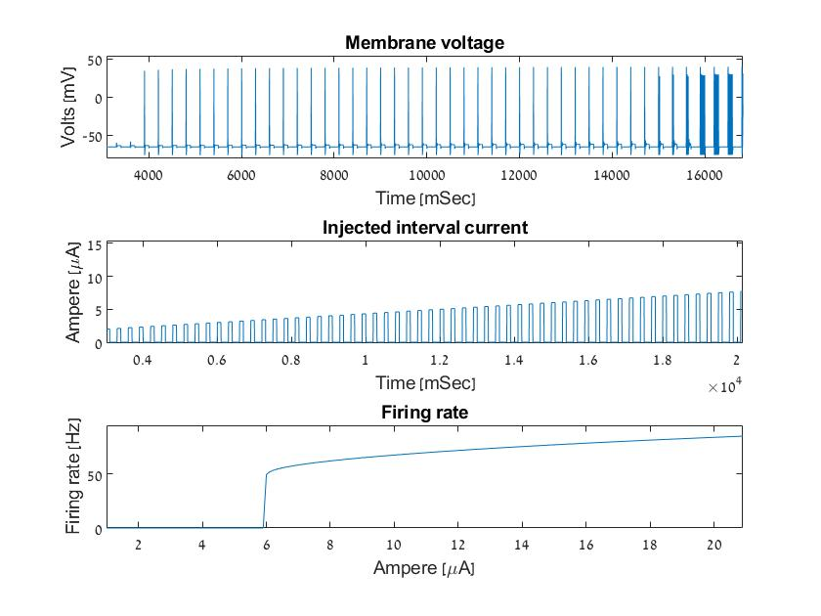
Paragraph 6 – further explanation
Even though the neuron fires between ~4-15Sec trial time, it isn’t shown in the lower graph. The reason is lack of repetition.
In order to calculate the rate, it is necessary that the neuron will fire more than once. Hence, the firing rate growth starts approximately at 15Sec trial time ~ 6uA (as shown in the middle graph).

